Slide 1
Online Safety
Arizona Attorney General
Mark Brnovich

Slide 2
Social Networking Apps
Facebook
Instagram
Twitter
Snap Chat
Vine
Periscope

Slide 3
KNOW WHAT YOUR KIDS ARE
SIGNING UP FOR!
Notes:
Any child or teenager that has any sort of electronic device has probably downloaded at least one app. Whether it is on their phone, iPad, tablet, or kindle it is important as parents that you know the terms and conditions of each and every application. The reason being is that many of the applications fully state that they can do whatever they want whenever they want with the information being transmitted through that application.
For example, Snap Chat, there is a section within the terms and conditions that gives them the right to utilize the camera on whatever device the app was downloaded to. Meaning, they can turn it on, take pictures with it, record, etc. Additionally, Snap Chap advertises that the photos will only be viewable for 15 seconds for the other person, however, in the terms and conditions it states that they own the rights to all of the photos taken through their app. so the photos are never really gone.
You don’t need to worry about the terms and conditions of every app out there, but it is important to know which apps your kids are downloading and what it can do.

Slide 4
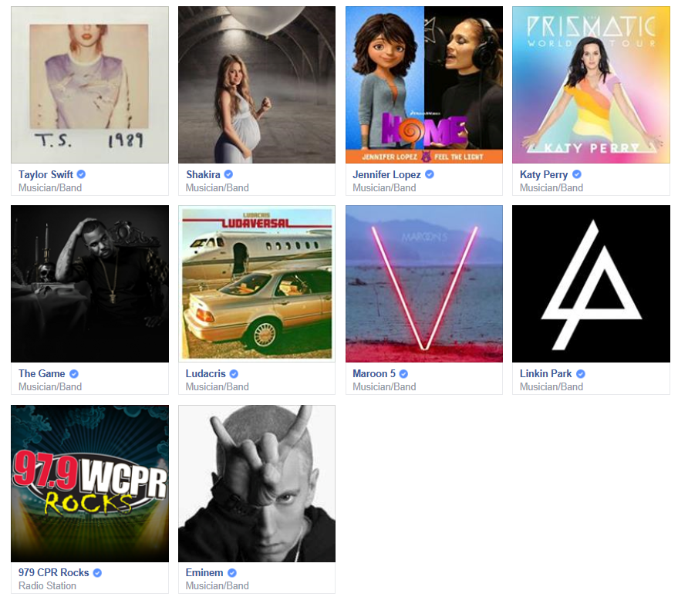
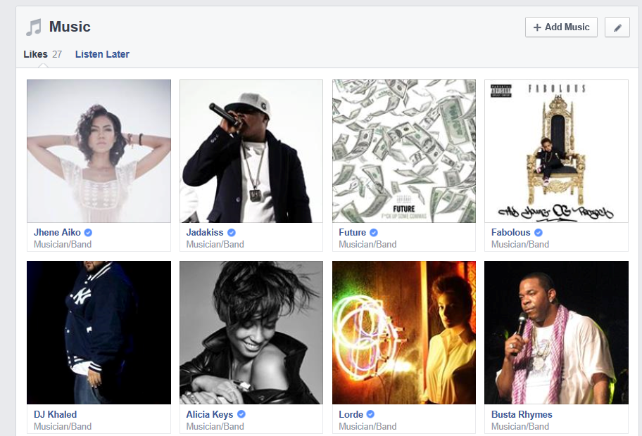
Private vs. Public Social Media Accounts

Slide 5
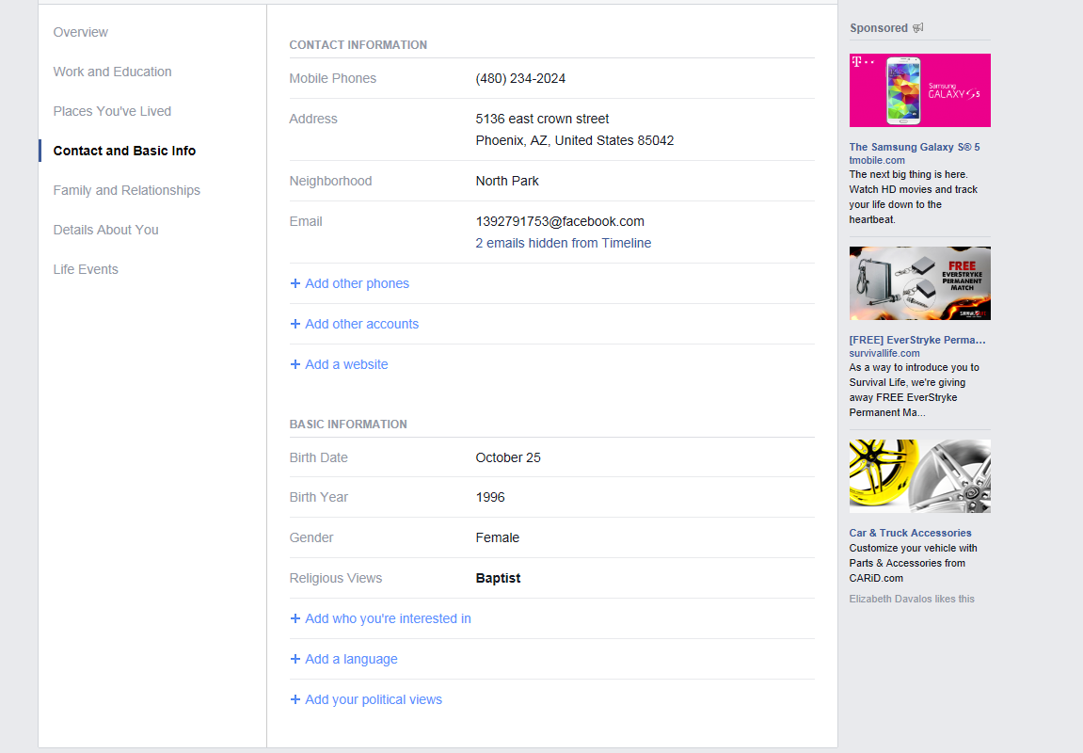
Cell Phone Number
Home Address
Email Address
Real Year

Slide 6
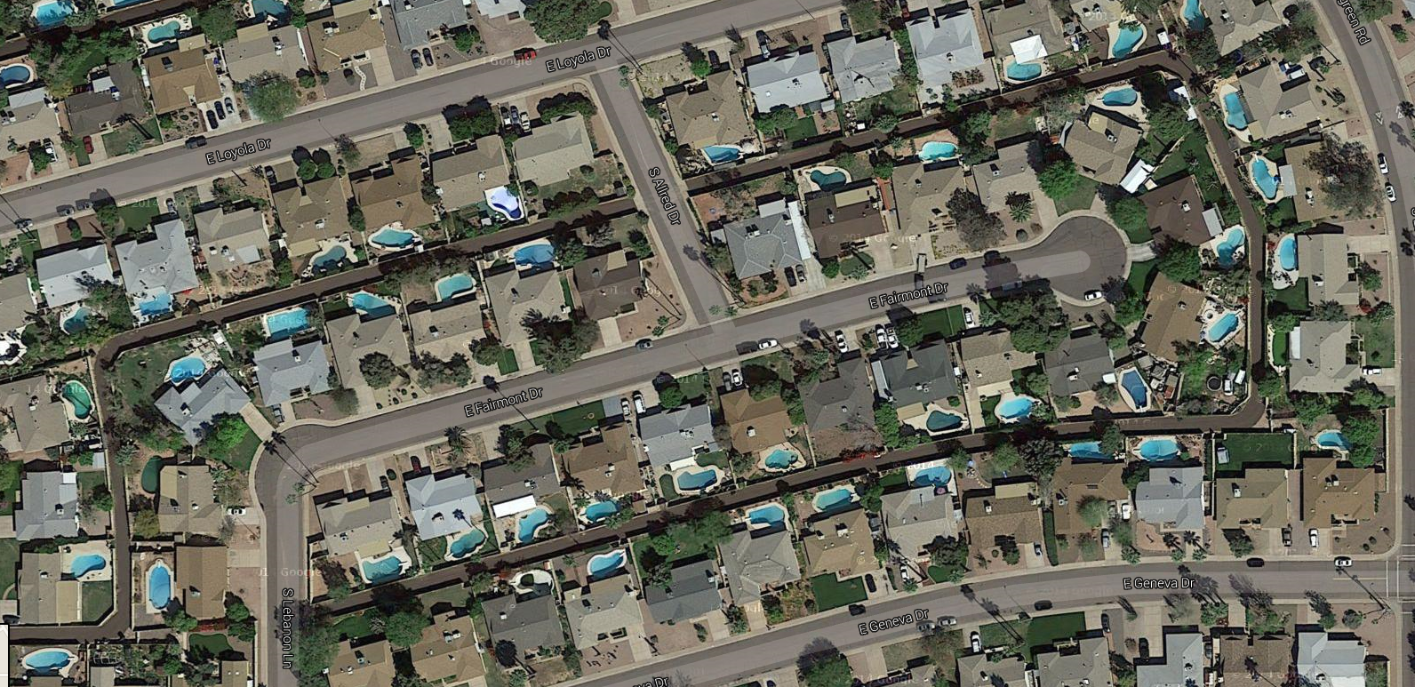

Slide 7
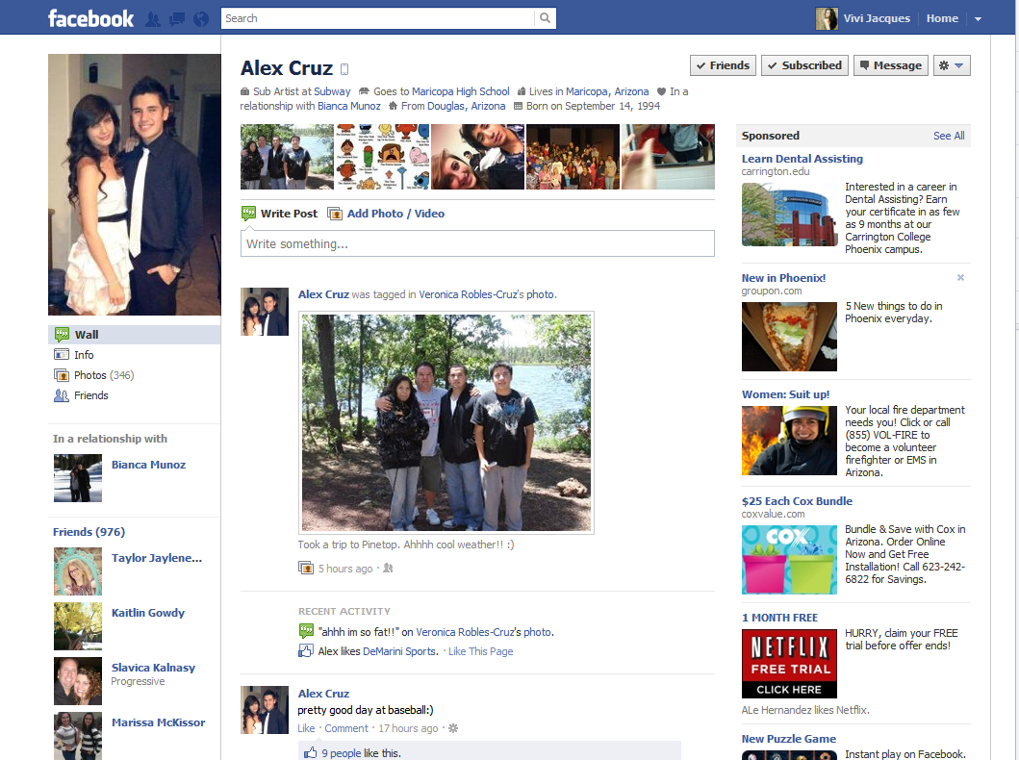
Notes:
By a show of hands, who would add Brian? ( A few hands go up)
Who would accept Brian because you have 5 mutual friends with him? (More hands go up. [Sometimes None])
Brian states a lot of information:
He works at Subway, it list his high school, where he lives. It says he is in a relationship, where he is from and his Birthday.
He went to Pinetop, and likes baseball. He seems like an average kid.
Would you add him, why or why not? (Different respond every time.)
Would you add someone randomly because you think their cute, or hot? (Open-ended Question)
What if a cute guy/girl sent you a private message, would you reply?
Who in here has 300 friends? (Pick on someone)
Have you shaken all XXX (number) people’s hands?
(Typically they say no, the younger the age group).
Who has 500 or more? (Use whatever number you like)
If I told you to pull out your phone out right now, can you call all XXX(number) of people and say:
“Is this you wearing Black Pants and a Weird looking Superman Shirt?”
(Rare case when they say Yes, usually response is No)
[For Yes, ok maybe you went to a different school, or you went to camp.)
If your adding people you don’t know, people you have never met like Brian……

Slide 8
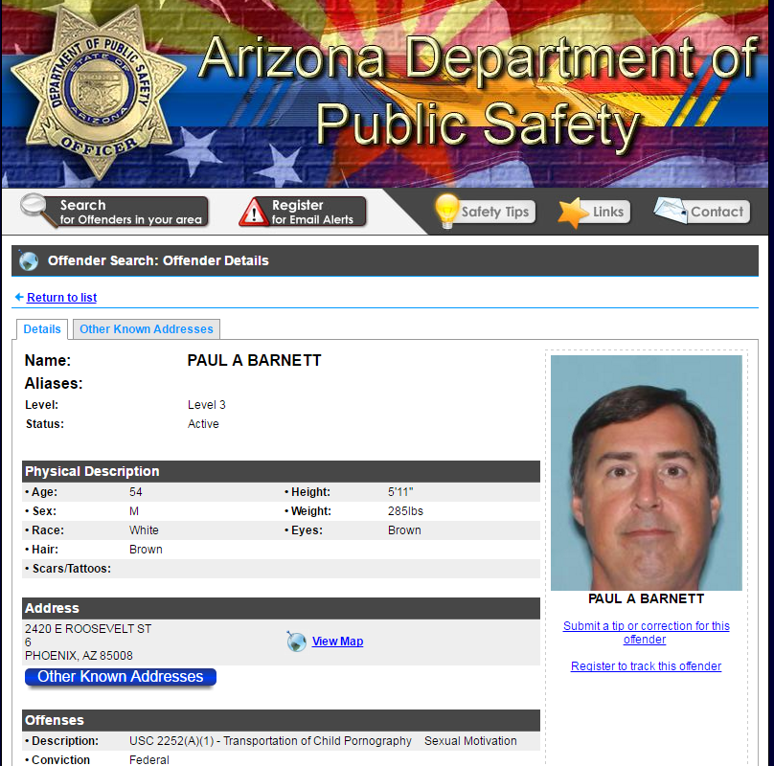
Notes:
This is a slide we show to people to really illustrate the point that anyone can create a fake profile online. Someone like this could get online and say that he was an 18 year old high school senior with a different picture and false information. People like this will try anyway possible to get their foot in the door with their targets. Police find that some of these predators have upwards of 300 different profiles online. That is why it is so important to remind kids not to add or friend people that they do not know. Have them make that rule for themselves and explain why it is important that they want to keep these people out of their virtual world.
Our last video is about teens who survived encounters with people they met online.

Slide 9
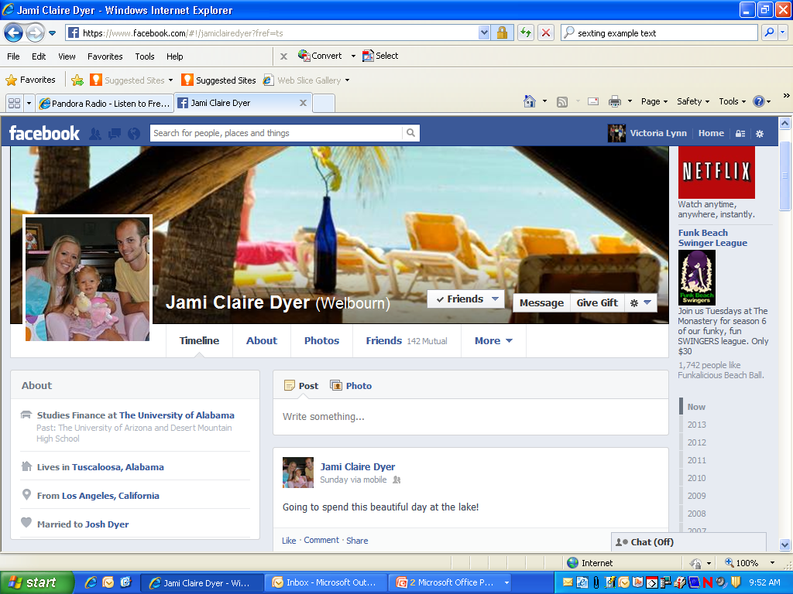
YOUR Social Networking Sites…
Lives in Scottsdale, Arizona
Notes:
One thing we do want to mention is also social networking that we as adults use. So many of us use it to reconnect with old friends or keep in touch with people we normally wouldn’t have. It is a great way for us to network with other people. But you also want to be careful about what you are posting online as well.
Many parents have pictures and information online about themselves but also about their families. You will want to make sure that you also have privacy settings set up if you have pictures and information about your kids. We just never know how a predator will find their next target so we just need to make sure we follow the good safety practices that we teach our kids as well.

Slide 10
What can you do?
FAMILIARIZE yourself with popular apps
KNOW their accounts
SET UP privacy restrictions
ASK questions
KNOW their phones’ capabilities
COMMUNICATE the dangers of talking with strangers online
Notes:
One of the scariest issues that parents have to deal with when their child starts using the internet is the types of predators that are out there and the knowledge that they could target anyone. Here are some suggestions to help protect your kids from online predators:
- Familiarize yourself with apps and websites your kids are using.
- Set up email and chat accounts with your children. Make sure you know their screen names and passwords and that they don't include any personal information in their online profiles.
- Make sure their privacy settings are set up on all electronic devices and social media accounts, including video game consoles.
- Ask questions. - What app did they download, how does it work, who are they talking to, who has contacted them???
- Know what their phones are capable of.
- Constantly remind kids of the dangers of people online, stranger danger still applies when kids are surfing the net.

Slide 11
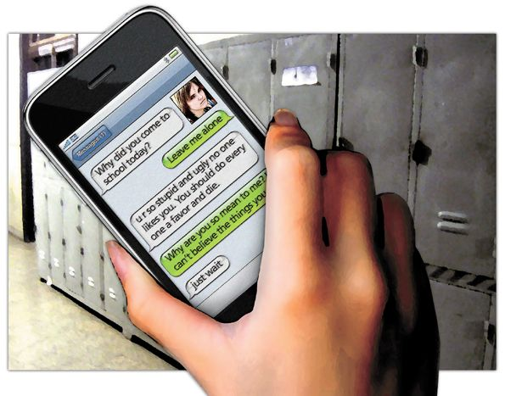
CYBERBULLYING
Cyberbullying is bullying that takes place using electronic devices and equipment such as cell phones, computers & tablets via social media sites, text messages, chat and websites.
Notes:
Examples include; mean text messages or emails, rumors sent by email, text or posted on social networking sites, embarrassing pictures, videos, websites or fake profiles.
https://www.cdc.gov/violenceprevention/pdf/bullying-suicide-translation-final-a.pdf

Slide 12
Arizona Bullying Laws
Bullying and cyberbullying are referred to as harassment and threatening or intimidating another person.
This includes harassment done via electronic means (such as telephone, the Internet, social media sites, texting, email, instant messages, or other similar means).
Misdemeanor harassment/threatening/intimidating: a
maximum sentence of 6 months in jail, a fine of $2,500 or both.
Felony Aggravated Harassment: a minimum of 6 months and a maximum of 2 years in prison, a fine of $150,000, or both.
Notes:
Arizona law makes it a crime for any person to harass another person and includes harassment done via electronic means (such as telephone, the Internet, social media sites, texting, email, instant messages, or other similar means).
Under Arizona law, bullying and cyberbullying are referred to as harassment and threatening or intimidating another person. Arizona law defines harassment as conduct directed at a specific person that would cause a reasonable person to be “seriously alarmed, annoyed or harassed” and that, in fact, does have that effect on the person targeted. (Ariz. Rev. Stat. Ann. § 13-2921.)
The penalty for misdemeanor harassment is a maximum sentence of six months in jail, a fine of $2,500, or both. (Ariz. Rev. Stat. Ann. §§ 13-707, 13-802.) The penalty for misdemeanor threatening or intimidating conduct is a maximum sentence of six months, a fine of $2,500, or both. (Ariz. Rev. Stat. Ann. §§ 13-707, 13-802.)
The penalty for felony aggravated harassment is a sentence of a minimum of six months and a maximum of two years in prison, a fine of $150,000, or both. (Ariz. Rev. Stat. Ann. §§ 13-702, 13-801.) A person convicted of a second offense of aggravated harassment faces a minimum sentence of four months and a maximum sentence of one year and six months, a fine of $150,000, or both. (Ariz. Rev. Stat. Ann. §§ 13-702, 13-801.)

Slide 13
Real Life
PEORIA, AZ – February 14, 2017. Police have arrested a
12-year-old Peoria boy after he made a threat against Santa Fe Elementary School via social media, posting a picture of a gun.
The boy was booked into the Durango Juvenile Detention Center on a hoax charge, other charges may be added.
Notes:
Also… Mar 29, 2017 - Peoria police arrested a 16-year-old Liberty High School student in connection with a threat posted on Facebook targeting the Peoria school
Jan 30, 2017 - Peoria police say they have arrested a 14-year-old girl on suspicion of making threats on social media

Slide 14
Instagram post gets 15yr old boy arrested
The teen has been accused of creating an online “burn book”.
Pictures taken from students Facebook pages, uploaded onto Instagram with derogatory comments.
According to police “We were able to track the person who did that through their IP address.”
Teen was arrested and charged 5 counts of third-degree harassment

Slide 15
Tell someone - Always report it!
Never retaliate.
Block them or tell them to stop.
Keep the evidence. Save. Print. Screenshot.
Call the police if it involves threats of violence.
Notes:
Cyberbullying.org/resources/teens

Slide 16
THE RELATIONSHIP BETWEEN
BULLYING AND SUICIDE
In the past decade, stories of a young person’s suicide linked, in some way to bullying, have become regrettably common.
Youth who report bullying others and being bullied, have the highest
risk for suicide related behavior.
ANY involvement with bullying behavior is a factor which may significantly contribute to feelings of helplessness and hopelessness that raise the risk of suicide.

Slide 17
Role of Social media
In a study conducted by Hinduja & Patchin in 2012, where appx. 2,000
middle school students were surveyed:
Victims of cyberbullying were almost 2 times as likely to attempt suicide than those who were not.
Cyberbullying offenders were 1.5 times as likely to report having attempted suicide than children who were not offenders or victims of cyberbullying.
According to The National Institute of Health, the role of social media in suicide is a new phenomenon and more research is necessary.

Slide 18
HOW TO REPORT:
Instagram: offers a feature very similar to Facebook’s. Users can anonymously flag a post and the 24 hr. team will review it and reach out. https://help.instagram.com/388741744585878
Twitter: also has a reporting service for tweets that indicate risk for self-harm. https://support.twitter.com/forms/suicide
Snapchat: does not have a form specifically for self-harm reports. Here’s how to report a Snap from another Snap chatter's Story:
1. Go to the Snap you want to report
2. Press and hold on the Snap
3. Tap the 🏳 button that appears in the bottom-left corner
4. Let us know why you want to report this Snap!
https://support.snapchat.com/en-US/i-need-help

Slide 19
What can you do?
DISCUSS cyber-bullying and internet challenges
MONITOR the home computer
KNOW their accounts/passwords
Know what apps they are using on their phone
Notes:
So, how can you as parents help your kids when it comes to cyber-bullying? These are not the only things you can do they are just some tips that we have found that may be helpful to parents:
- Discuss cyber-bullying with your children and ask if they have ever experienced it or seen it happen to someone
- Keep your home computer is a busy area of your house.
- Set up email and chat accounts with your children. Make sure that you know their screen names and passwords and that they don't include any personal information in their online profiles.
- Tell your children that you won't blame them if they are cyber-bullied. Emphasize that you won't take away their computer privileges - this is the main reason kids don't tell adults when they are cyber-bullied.

Slide 20
SEXTING
The act of sending sexually explicit messages and/or photographs, through an electronic device.
Notes:
The next topic I want to discuss is sexting. For those of you that might not be familiar with sexting, it is the act of sending a sexually explicit image or message through an electronic device. Its name comes from the fact that most kids and teens are taking these photos and sending these messages through text.
The problem with sexting is that today’s youth have started using it as a new way to flirt with each other. We are not only seeing this happen between teens in relationships, but also between two people who might have a crush on each other, or even just between friends. Kids are becoming more and more desensitized to it and because of that they see it as being less harmful than it actually is.
The video we will watch talks about the dangers of sexting from kids who have been involved with it firsthand.

Slide 21
Arizona Law Makes ‘Revenge Porn’ A Felony ARS§13-1425
Class 5 felony (up to 2.5 years in prison).
If the person is recognizable in the image, it is a Class 4 Felony which is punishable of up to 3.75 years in prison (Plus a fine of up to $150,000).
If a minor posts a picture of a minor that depicts sexual conduct then the minor would be charged with sexual exploitation.
Class 1 Misdemeanor to simply threaten to send explicit pictures of someone even if they do not send any images to anyone (Up to 6 months in jail and fine of $2,500).
If a minor posted a picture of a minor that is just nudity and the picture is NOT sexual conduct then it would be punishable under ARS §13-1425.
Notes:
In Arizona, the law states that it is a FELONY to intentionally disclose images of another person in the state of nudity or other sexual act with the intent to harm, harass, intimidate, threaten or coerce.
“Disclose By Electronic Means” includes sending or posting images via e-mail, mobile device, tablet, electronic device or website.
“HARM” MEANS PHYSICAL INJURY, FINANCIAL INJURY OR SERIOUS EMOTIONAL DISTRESS.
“IMAGE” MEANS A PHOTOGRAPH, VIDEOTAPE, FILM OR DIGITAL RECORDING.

Slide 22
The information kids and teens post online can determine whether they make athletic teams or student organizations.
And can be viewed by scholarship committees, colleges and future employers.

Slide 23
Important Tips to Think About When Using Social Media
Be aware of the websites you are on and if you are talking to people online that you do not know.
Exit out of a website or log off a game if someone starts asking personal questions.
Always assume that at least 4 people are going to see everything you ever post. Are you going to be proud, happy, humiliated, embarrassed of what they see???
Your Parents
Your best friend
Your school principal
Your future employer
Be smart, everything is saved somewhere!

Slide 24
What can you do?
COMMUNICATE with your child or teen
UNDERSTAND the consequences of sending out explicit photos
REMEMBER that their cell phones are YOURS
Notes:
Again, when learning about an important issue that kids and teens are facing today, parents often ask themselves, what can I do? Here are some suggestions when it comes to sexting:
- Communicate with your child or teen - help your teen understand the ramifications of engaging in this type of behavior. Failure to do so can lead to emotional damage, embarrassment and even serious legal charges.
- Understand that harassment happens-Many girls and boys send naked pictures because of pressure by a partner. Remind them that someone who actually cares about them won’t push them to do anything uncomfortable or inappropriate.
- Remember that their cell phones are YOURS.

Slide 25
PREDATORS
There are all different types of predators
that use the internet to target kids.
Notes:
The last topic that I want to cover is predators. Because of the constant use of technology, predators have turned to the internet to find their next victims. Parents need to know the types of predators that are out there and what they can do to help protect their families.

Slide 26
Who are cyber predators?

Slide 27
True or False: Cyber Predators spend a long time Chatting online before Meeting a victim Face to face.
RESEARCH SHOWS IT CAN TAKE JUST
18 MINUTES FOR PREDATORS TO ARRANGE TO MEET THEIR VICTIM

Slide 28
So, Does it happen here?
YES!
In fact, 1 in 7 Youth have received unwanted solicitations from cyber predators.

Slide 29
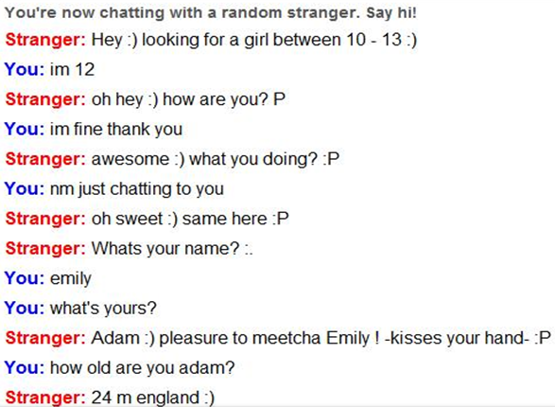
Chat with Strangers
Notes:
This slide shows a chat of an actual conversation on a site called OMEGLE. The tag line of this site is “Talk to Strangers,” can you see where I am going? It seems natural for kids and teens to want to talk to new people as they grow up. But we really need to remind them of the dangers or sites like these. The people who are looking for specific age groups know what they are doing and how to get them to talk.
(Read off the conversation from OMEGLE)
This next video is a perfect example of just how a predator thinks versus a teenage girl.

Slide 30
Additional Resources

Slide 31
Request our Internet Safety Guide in English or Spanish for FREE!
You can submit a request online at www.azag.gov/publications

Slide 32
Thank you!
For more information please contact Community Outreach:
602-542-2123
www.azag.gov

